Slide 1
SaaS Platform for APTRANSCO & Banking Exam Preparation
AI-powered Mock Tests, Practice & Analytics

Slide 2
Problem Statement
Current exam apps are generic & outdated
No APTRANSCO-specific content
No AI-based personalized feedback
Students need engaging & affordable solutions

Slide 3
Our Solution
SaaS platform for APTRANSCO + Banking exams
AI-generated questions & feedback
Mock tests & practice sets
Gamification (coins, badges, leaderboards)

Slide 4
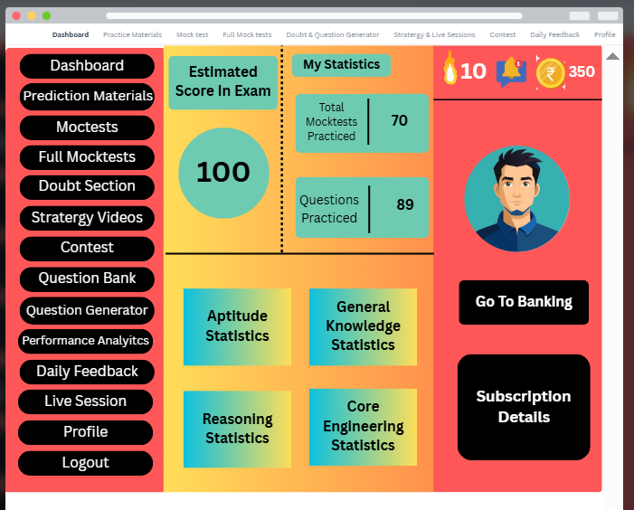
Blueprint

Slide 5
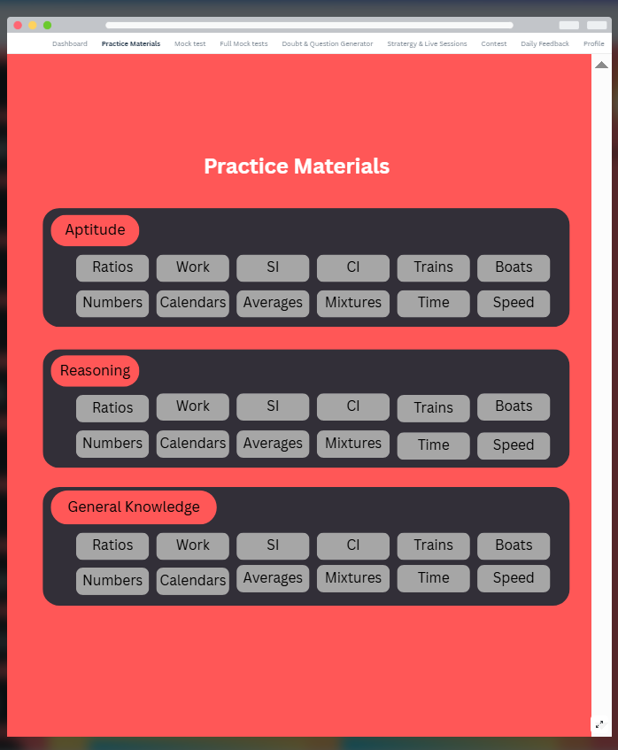
Blueprint

Slide 6
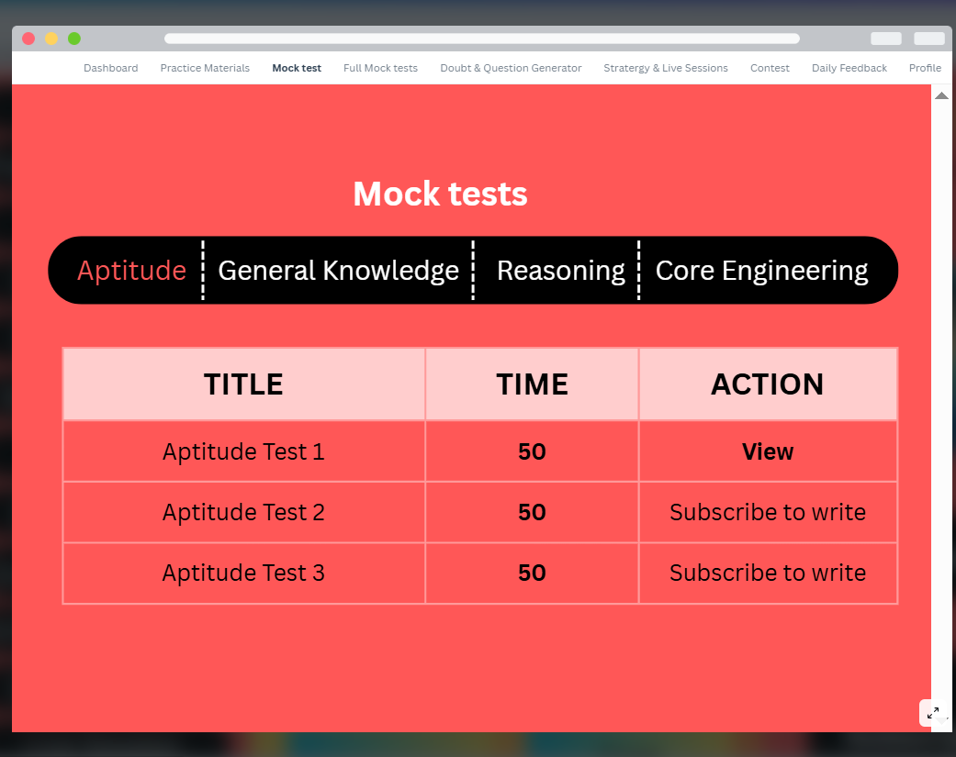
Blueprint

Slide 7
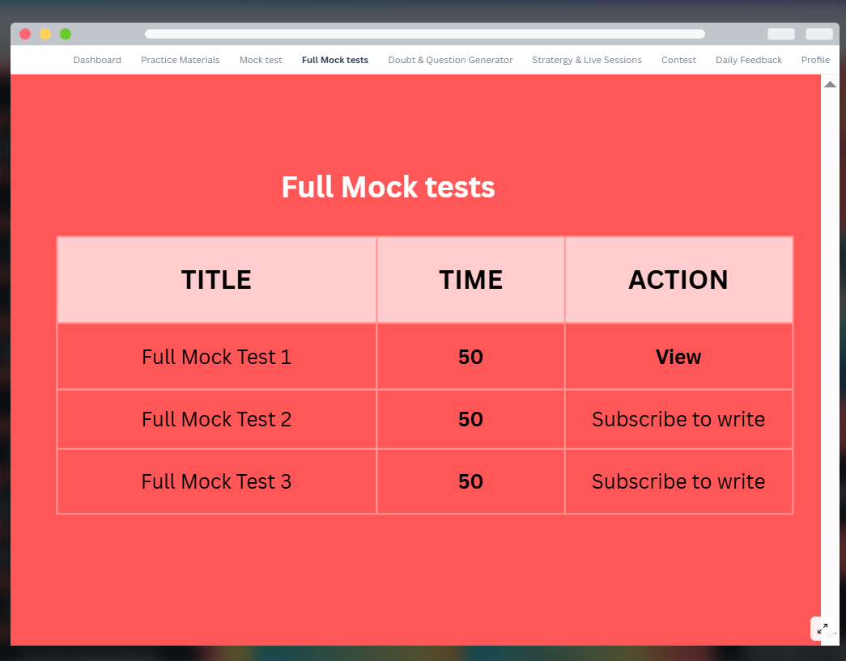
Blueprint

Slide 8
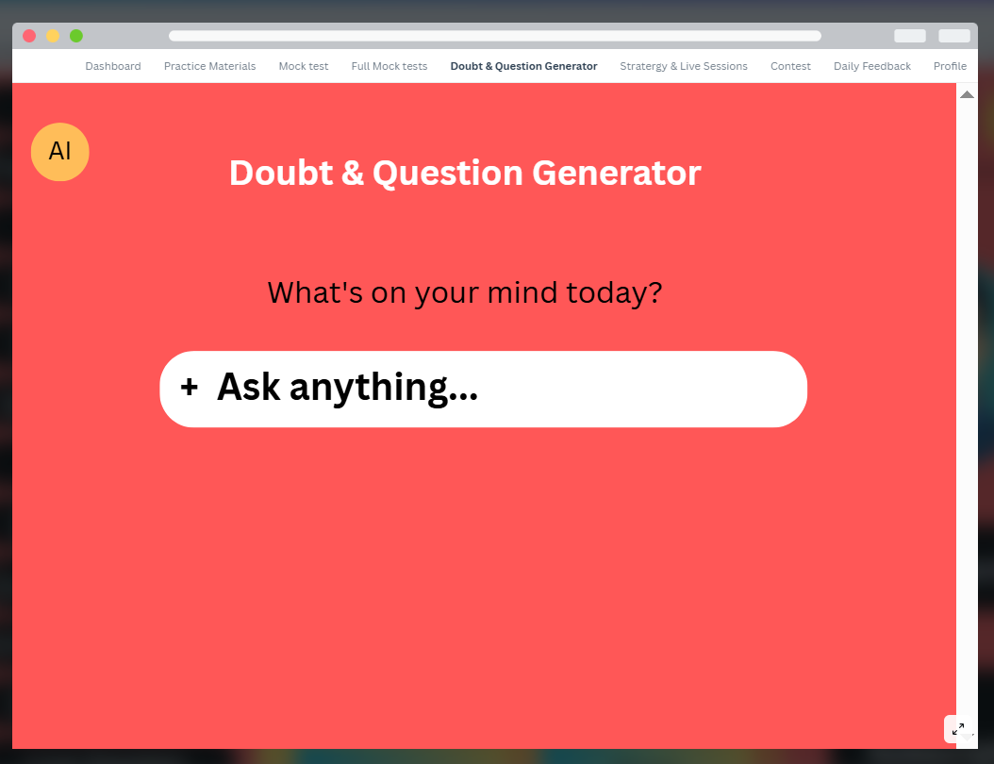
Blueprint

Slide 9
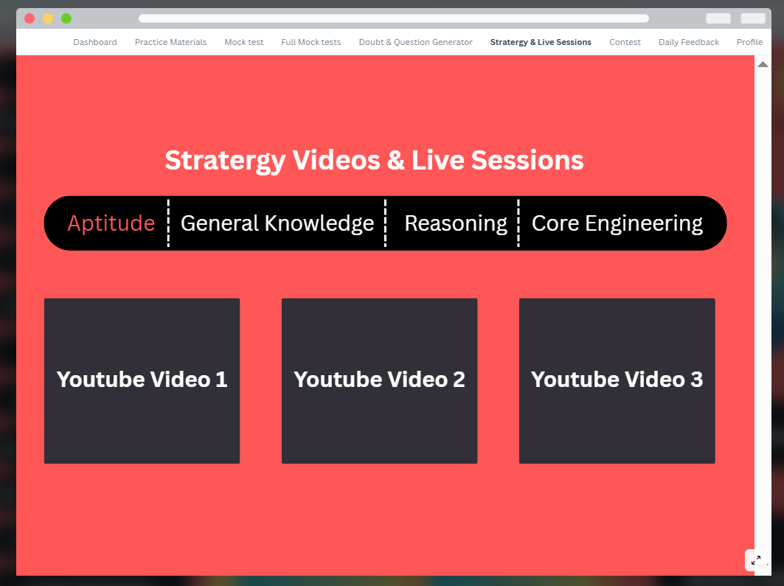
Blueprint

Slide 10
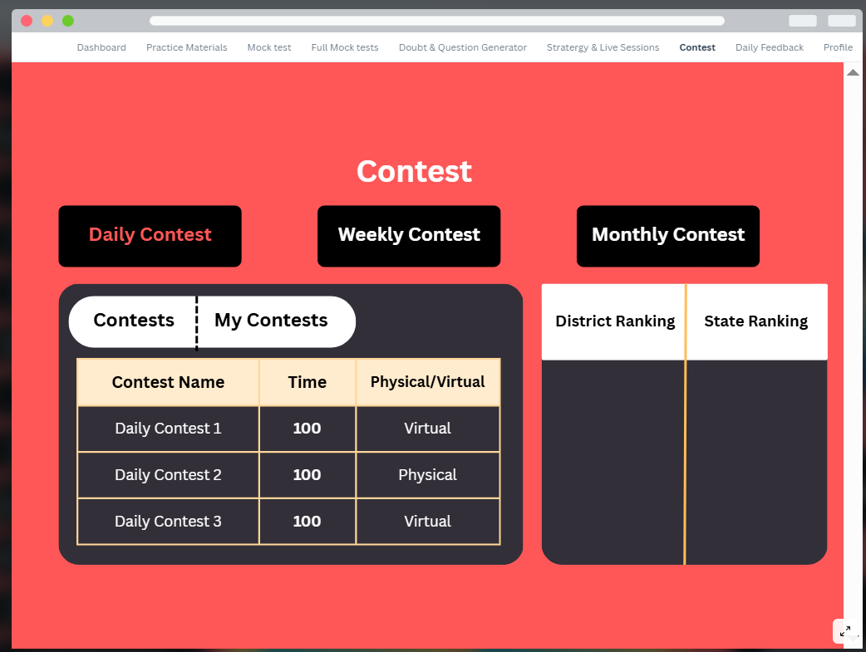
Blueprint

Slide 11
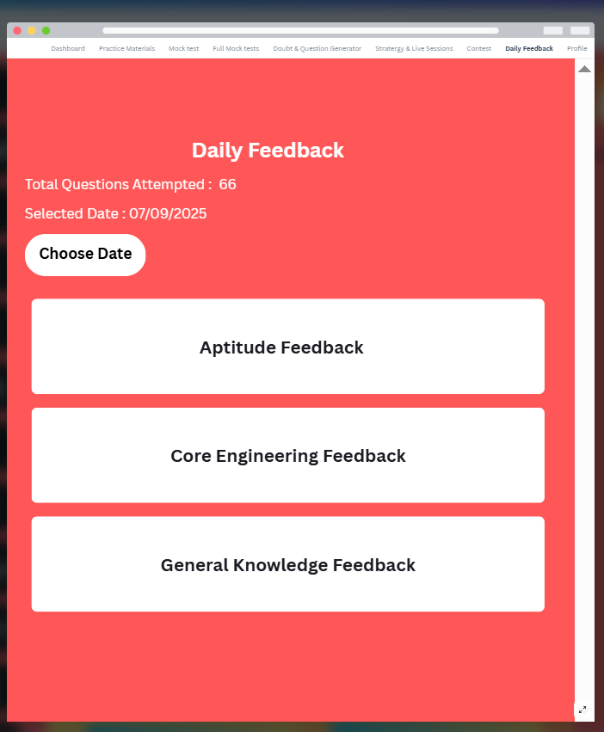
Blueprint

Slide 12
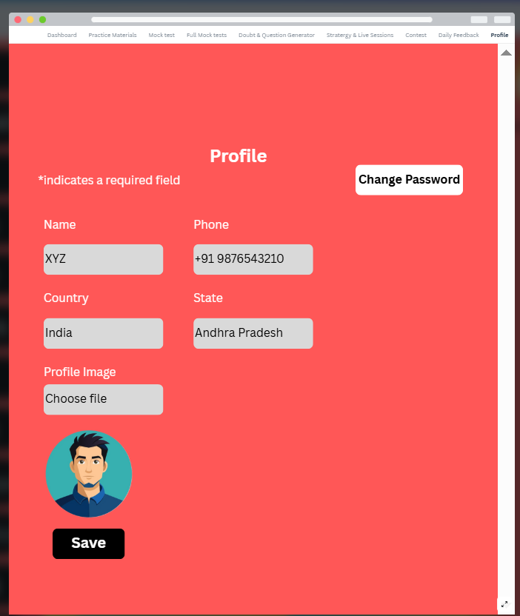
Blueprint

Slide 13
Key Features
Dashboard
Question Bank (main core)
Practice Materials
Mock Tests (full/sectional)
AI Doubt Section
Secret Strategy Videos
Daily AI Feedback
Performance Analytics Dashboard

Slide 14
Unique Features
AI Question Generator
District & State Level Contests
Gamification Layer (coins, ranks, badges)
AI-driven personalized study plan
Subscription-based SaaS model

Slide 15
Tech Stack
Frontend: Next.js, Tailwind CSS, Redux, Chart.js
Backend: FastAPI, Redis, Celery/AWS SNS, JWT/OAuth2
Database & Storage: PostgreSQL, FAISS, AWS S3
Payments: Razorpay
Infra: AWS, Docker, Kubernetes
AI: Hugging Face, LangChain, PyTorch
Monitoring: Prometheus+Grafana, ELK Stack, Sentry

Slide 16
Workflow Example (Mock Test Flow)
1. Student starts test (Frontend calls API)
2. Questions fetched from DB via FastAPI
3. User submits answers
4. Score + AI feedback generated via Celery
5. Dashboard updated with performance analytics

Slide 17
Revenue Model
Freemium: Free basic tests + Paid premium
Subscription Plans: Monthly / Yearly
Contest participation fees
AI-powered doubt solving as add-on service

Slide 18
Benefits
For Students → Easy prep, personalized, engaging
For Institute → Scalable SaaS model
For Investors → High growth, recurring revenue

Slide 19
Roadmap
Phase 1: MVP with Question Bank + Mock Tests
Phase 2: AI Doubt Section + Gamification
Phase 3: Live Sessions + District/State Contests
Phase 4: Advanced AI Study Plans & Expansion

Slide 20
Conclusion
This SaaS platform is unique, scalable, and tailored for
APTRANSCO + Banking exams.

